Slide 1
Scenario
Leonie is in year 8 and you are in the evening of the first day of a residential. Leonie appears to be very upset and is crying when the children are asked to get changed and ready for bed.
When you speak to her she says that she “can’t go home” and repeats “I can’t do it any more.” When you ask her explain that to you she says that she can’t hide it any longer and shows you her lower back where you can see what appear to be bruises.
You then ask her to tell you more about what has happened and she just keeps repeating that she can’t go home and she can’t do this any more. Leonie is a quiet student. You have no knowledge of any previous concerns of this nature, but she has been identified as a pupil who may need some additional support with self esteem / confidence.
What do you do?
Notes:
Immediate
Reassure Leonie she has done the right thing in telling you.
Contact the safeguarding lead at school. What if over the weekend?
Next steps –
May be actioned by the designated lead Speak to parents / carers and enquire whether everything has been ok at home and enquire as to where it might have come from.
It is likely that a consultation with SPA will need to happen.
Recording
Complete a record of concern, also completing the body map, marking where the injury was seen, the approximate size, shape and colour and clearly noting
Leonie’s exact words.

Slide 2
LSCB Safeguarding Children: A Shared Responsibility (Level 2)
Session 1

Slide 3
Before we start!
Try to avoid looking through the booklet… it will spoil the surprise!

Slide 4
Aims
Session 1
To provide an overview of local and national statistics, emerging themes and trends in safeguarding an child protection
To give an understanding of effective multi agency communication and information sharing
To consider how this might look at school
To consider the referral and assessment process when safeguarding concerns are identified
Session 2
Undertsand what the SPA is and how to make a referral
Understand some CP issues:
Private fostering
County lines
Trafficking
Radicalisation

Slide 5
Count the number of times the players in white pass the ball
Notes:
Show The Monkey Business Illusion
How does this relate to safeguarding and protecting children?
It is easy to miss things if you are not looking for them. If you have the view that- ‘it doesn’t happen here’ you will not see it when it is in front of you. Think the unthinkable
Did you see the monkey?
Did you see curtain changing colour or the person leaving the group?

Slide 6
Quiz
Which form of abuse is the most common?
Neglect
Which form of abuse has had the highest % increase in referrals in the last 5 years?
Sexual
Are children safer now then they were a generation ago?
It depends
Notes:
Jot the answers down on your table.

Slide 7
Notes:
How Safe are our Children NSPCC 2017How Safe Are Our Children 2017
NSPCC helpline received 66,218 contacts (2016/17). This is a 21% increase since 2015/16
Of the four abuse and neglect categories, neglect has been the highest concern for the past five years
After years in decline, suicide rates for 15-16 year olds have started to rise in England
The rate of recorded sexual offences across the UK has doubled since 2005/6, with 2015/16 seeing the highest number of offences in the past decade
Possible reason is we are now far more aware and there has been a cultural shift
Changes in the perceptions of society
We are now more happy to intervene and children are taken more seriously
Child homicide (when a child is killed by another person) is on the long term decline

Slide 8
Local Statistics- Kingston & Richmond Child Protection Plans
Richmond January 2018
Kingston December 2017
Sexual abuse 5
Neglect 41
Emotional abuse 42
Physical abuse 17
Sexual abuse 6
Neglect 53
Emotional abuse 50
Physical abuse 34
Notes:
These statistics are a current snapshot of the number of children with child protection plans in Kingston and Richmond and are included to give some local context and awareness of the key areas of concern.
CP Plans for neglect reflect the national trend as being the most common reason for a child to have a CP Plan

Slide 9
Increased vulnerability
On your table, consider the factors that might make a child more vulnerable to abuse.
Jot down your thoughts in the booklet
Notes:
Use sticky notes and put up on wall

Slide 10
Increased vulnerability
Children may be more vulnerable to being harmed if they are:
Babies
Young carers
Have a learning difficulty or disability
Children in care or in secure accommodation
Privately fostered
Those experimenting with drugs and alcohol
Those with a history of child abuse
Those with parents who misuse drugs and alcohol
Those who have experienced or witnessed domestic violence
Children or parents with disabilities or learning difficulties
Families with chaotic, unsettled or transient lifestyles

Slide 11
Recognition-Activity
Physical abuse
Sexual abuse
Emotional abuse
Neglect
In your groups write down 3-5 signs or symptoms for each category of abuse under four age groups: Pick the age group that you work with the most: 5-10 and 11-18 years
Notes:
Reminder of the 4 types of abuse and how we might spot them in our setting.

Slide 12
What factors might we look out for when assessing a safeguarding need?

Slide 13
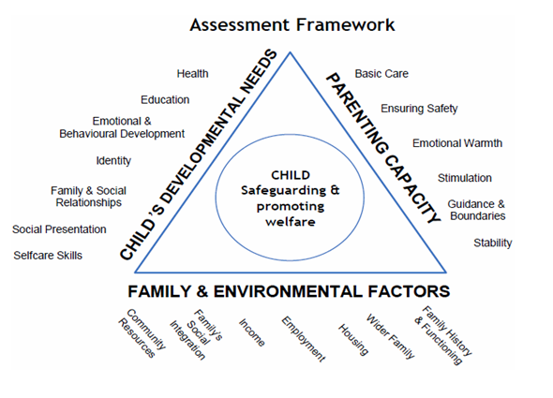
Assessment Framework Triangle – a quick game
Match the dimensions with the domain of the assessment area.
Notes:
When might we consider
Worth considering this as a way of spotting where intervention may be needed.
Try to match the
If the framework resemble ‘gappy teeth, likely that some extra help is going to be required.

Slide 14
Assessment Framework Triangle
Notes:
Worth considering this as a way of spotting where intervention may be needed.
If the framework resemble ‘gappy teeth, likely that some extra help is going to be required. #
Consider who might have information on the different aspects.
What information do schools have?

Slide 15
What information do we have on the Children at School
What information do we have at school that might help us identify a vulnerable child?

Slide 16
Assessment Framework Exercise
Looking at the domains and dimensions on the assessment framework triangle-identify for which of the dimensions would you/or the school have information regarding the child & their family
Notes:
What information do we have at School on the children?
Highlight the sheet and remember that this is what we are most likely to see.

Slide 17
Using the assessment framework, assess Jane’s situation
Jane is in year 10. Her attendance has been steadily getting worse over the past six months and is now at 78%. When she is in school she sometimes misses lessons and goes to the medical centre. She has received a number warnings for lack of school uniform, a negative attitude and lack of homework.
In her recent 1:1 tutor discussion, she disclosed that her mum was more interested in her younger brother than her.
Notes:
Flip charts
Get groups to consider on the flip chart what is going well and what the concerns are using the framework.

Slide 19
She has not attended school for the past three days. In form time on Tuesday, Chloe, Jane’s friend, said that on Friday Chloe went to a party and didn’t go home until Sunday. She said that Jane’s mum didn’t know where she was on Saturday but isn’t worried because she often stays out overnight and always comes back in the end

Slide 21
Mum is invited into School
Mum is a single parent and has a toddler to look after. She is supportive of the school but is struggling to cope with Jane.
Mum notes that Jane’s father has recently been trying to contact the family and has left messages at home. She notes that her father walked out on the family when Jane’s younger brother was born.

Slide 23
A member of staff contacts you to say that they are worried about Jane. They noticed some scratches on her arm.
There is increasing concern that the young person is hanging around in King Charles Park – a known spot for drug dealers - at night.

Slide 25
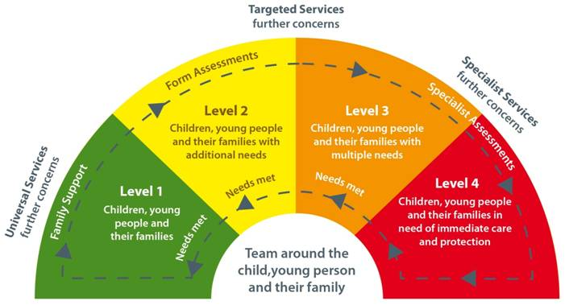
How do we decide who to involve?
Notes:
Continuum of need
Multi-Agency Threshold Document – multi agency threshold document.
Outline the purpose of this diagram – the move from universal support to specialist support.
The purpose here is to explain the levels of intervention and support available when needs are identified, with an emphasis on providing this support at the earliest opportunity to prevent concerns from escalating. The key messages – being able to manage risk at the preventative services level.
Explain notion of Team around the Child meetings.
At Surbiton we tend to manage the issues. When there is the need for a TAC meeting we would have referred to Children’s Services and taken their advice.

Slide 26
Continuum of need
Notes:
Important to note the flow of the continuum
School will talk to child, parents, specialists and involve Children’s services when unable to meet the child’s need. We may, for example, have a girl suffering depression but this is being managed by parents, a doctor and a counsellor, therefore no need to involve Children’s Services. If things don’t improve, then CAHMs referral may be required.
It is vital to note the differing levels of need and what this means locally;
Level 1 Children with no additional or emerging development needs. SPA will provide information, advice and guidance, including signposting to an appropriate universal service. It will provide support to identify individual children and young people’s additional needs by offering advice to complete the Early Help Assessment (EHA) checklist and assessment, identifying a lead professional and supporting the universal setting
This might include low-level self harm managed by the school
Level 2 Children with levels of additional need that vary in scale and complexity and their needs are addressed through early help and protection teams. Children with needs at this level also include more vulnerable children requiring multi-agency intervention, a lead professional and a Team around the Child (TAC) approach. At Level 2 the SPA will provide advice on the EHA checklist and assessment and will refer the case for allocation to the relevant early help and protection team, which will take on the lead professional role.
Girl who we believe is suffering from anxiety
Might include a girls whose attendance is low for medical reasons or is a school refuser
Level 3 Children whose level of vulnerability has increased and whose needs are complex or acute, and who are often likely to require longer term intervention. At Level 3 the SPA will refer the case to Specialist Children’s Services as the child will have been identified as a child in need or a child requiring protection from harm under the terms of the Children Act 1989.
Here the level of absence might be high > 20%
Girl may have depression
Level 4 Children who are suffering or likely to suffer significant harm – these children are suffering or are likely to suffer significant harm. They will require intensive support under Sec.47 Children Act 1989. This is the threshold for child protection. (discussed in more detail at LSCB Level 3 training)
Refer to the ‘Step up/ Step down’ protocol
Girl who is witnessing domestic violence
Sexual assualt

Slide 27
What we could do
How might we help Jane?
How do we determine what, if any help we can give her and her mother.

Slide 28
What is Early Help Assessment
The EHA is a shared assessment and planning tool to help us in our work with children, young people and families.
The EHA is beneficial where children need the support of more than one agency to address their additional needs, or when their needs are not clear
Using the EHA will help to provide effective co-ordinated support as early as possible
Early Help Assessment
Notes:
Early help means providing support as soon as a problem emerges. It enables us to efficiently identify the emerging needs of children and young people at risk of poor outcomes; it reduces duplication of assessment and improves involvement between agencies.
This is going to be a change from the current practice of referring to the Counsellor but might help to engage parents.
It enables professionals to efficiently identify the emerging needs of children and young people at risk of poor outcomes; it reduces duplication of assessment and improves involvement between agencies.
An early help assessment, undertaken by a lead professional should provide support to the child and family, act as an advocate on their behalf and coordinate delivery of support services. By working together, we can help children and families receive the right support to prevent a small need growing into a larger one.
HAND OUT FORM
When we are considering engaging the School Counsellor or seeking help from an outside agency we should be using this form.
A single holistic assessment can support the identification of:
Families needs
Risk factors and strengths
What support is needed to support better outcomes
Supports the sharing of information
Improve joint working & communication

Slide 29
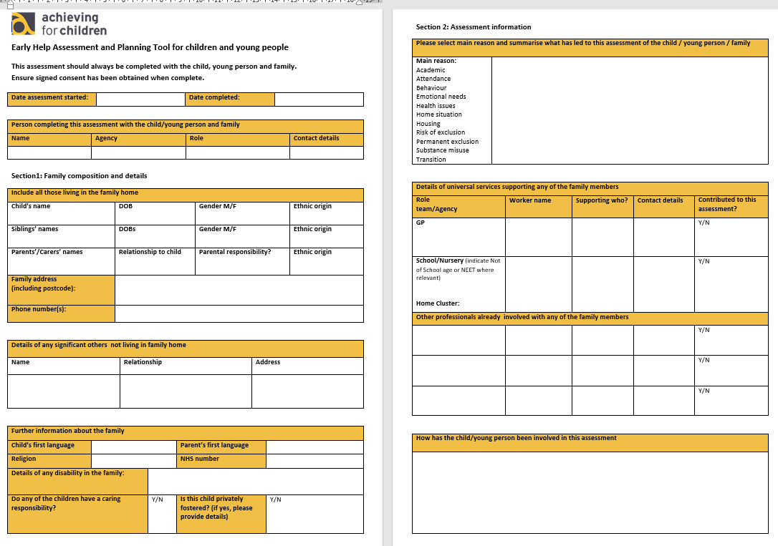
Notes:
We do most of this without realising and our contacts act as a record of what we do.
However, the form is a good starting point if there is growing concern and we are considering a referral to SPA.

Slide 30
Once complete might lead to a TAC
Team around the child
Meets ‘regularly’ to discuss how the child is getting on.
Formally closed
Usually led by a member of Children’s Services
School often facilitates the meeting
Child, Parent, school, school nurse, Tier 2 worker

Slide 31
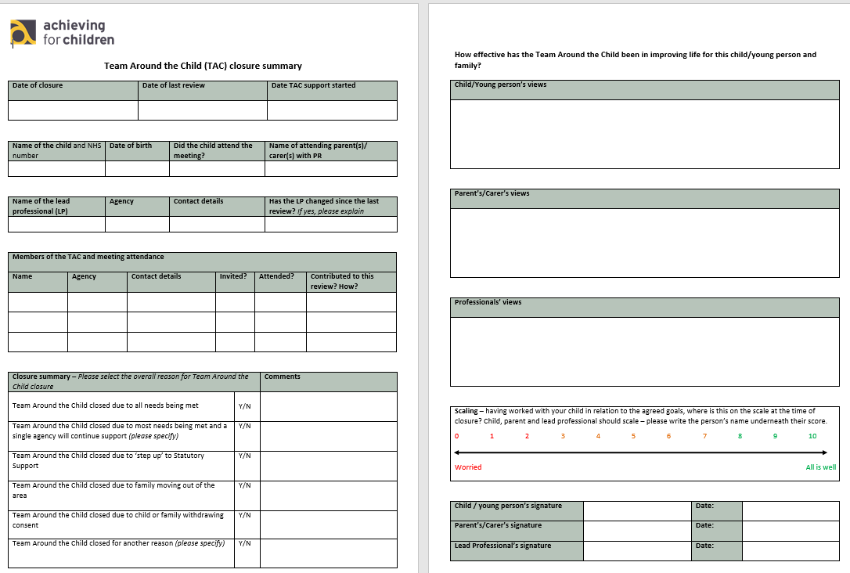

Slide 32
Let’s consider Jane

Slide 33
Any questions?

