Slide 1
Today you will be using documents here:
Open spreadsheet here: https://learn.surbitonhigh.com/careers/university/
Please open the spreadsheet: Y12 PSHE Spreadsheet with Law Example
Make sure you are logged into your Morrisby Profile
Notes:
Outset mention a lot of info – would love more time with you but….
Also weekend and c (not C)

Slide 2
Today: overview
Exploring your possible course in general, e.g. law
Exploring your university, e.g. Durham
Exploring your possible courses at specific universities, e.g. law at Durham
How to explore the content of your course to confirm your interest and then show this to the university, particularly in the personal statement “Curricular and Super Curricular”
Notes:
Curricular – you academics in schools (ie. A levels), Super curricular - your academics outside your studies, e.g. reading, lectures, etc.

Slide 3
Personal Statement: the importance of having explored your subject
Introduction (short)
About the degree subject – reference most closely related curricular (AL) and/OR ‘Super-curricular’ in chosen subject(s), inc. EPQ if you’re doing one
Develop argument about a few key topics in the degree subject
Other A-level subjects (only if relevant)
Extra-curricular (≤ 10%)
Ending (even shorter / omit)
4000 characters including spaces – 1 page Bold bit” part is what takes time, because you may have to decide what you’re going to study and then explore it in some depth to write a convincing personal statement using your subjects and your extra “reading”
Notes:
Why am I starting with a personal statement? Because a good personal statement shows someone that the person has explored the subject well and can therefore be convincing about their interest and suitability.

Slide 4
You have no idea or not sure
Look at subjects you currently enjoy (remember 2/3+ of careers can be entered with any degree)
Look at Morrisby degree/career suggestions
Other sources of inspiration (your career interview, other girls, talks you’ve been to)
Notes:
The point is rather than give you loads of websites to look through, which would be the easy thing to do, it’s about thinking the process you go through to research uni and make good choices…. I am going to use selected websites, because if I use too many, will just confuse but at the end of next week I will send you a letter with key resources.
There are some girls who are still not sure what they want to do and that’s fine. So my advice for them is….
Look at what you currently study because 2/3 of careers can be entered with any degree.
If looking at new subjects and vocational degrees, even more research is required as less likely to know what it is like…. So you need to explore these more and for vocational degrees, work experience will be important but be aware difference between amount – very vocational like medicine – and something like law or engineering.
If girl doesn’t like current subjects, maybe resist going with one of them or one like them… there are so many options…. Sometimes good to go with something more unusual if the right thing….
Other ideas of what to look at… Career Interviews, speaking to people but beware prejudiced views….
Final thing I said to get ideas, is look at your Morrisby Webspace degree suggestions..

Slide 5
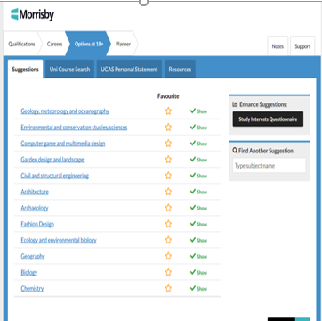
Notes:
Please look at the 18+ tab in your Morrisby profile – this gives you degree suggestions
Note that Study Interests Questionnaire doesn’t seem to be working atm

Slide 6
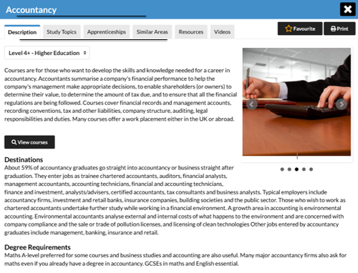
Overview exploration
Notes:
Note apprenticeship routes tab.

Slide 7
Making Connections Between Degrees
Psychology BA/BSc
Social Work
Human Resources
Psychology + Another Subject
Social Psychology
Health Psychology
Applied Psychology
Behavioural Science
Psycholinguistics
Medicine
Occupational Therapy
Speech & Language Therapy
Other Healthcare Areas
Counselling
Combined Honours
Notes:
Remember that before you were told so much choice at university – so make connections between current study and greater options at university. HOW? Next slide

Slide 8
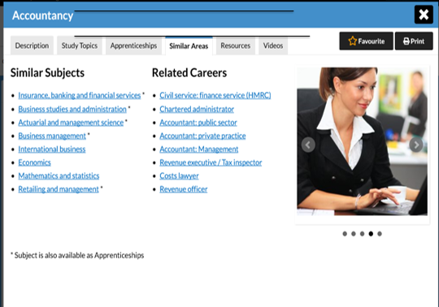
Looking at related degrees…
Notes:
In particular, even girl has decided accountancy degree area, she may not be aware of all the degrees in that area…. So she can look at allied degrees here….

Slide 9
Other ways to explore and decide on your subject
https://www.thecompleteuniversityguide.co.uk/courses
https://www.ucas.com/ucas/subject-guide-list
Possibly compare career suggestions in Morrisby to some courses….
Super-curricular exploration – “reading” etc… above and beyond your A levels… much more later

Slide 10
Flash Task 1
Read through your Morrisby degree course suggestions (18+ options) and related degrees suggestions.
Note down any that look vaguely interesting particularly if you don’t know what you want to do
Even if you know your degree, what interested related degrees can you find and/or interesting facts about your degree can you note down - perhaps things that you will need to evidence your ability to do in your personal statement 5 mins

Slide 11
Now looking at specific unis….
Remember you have 5 UCAS choices (one firm choice, one insurance)
Only 4 for medical, veterinary and dentistry
Deadlines:
15 October 2020: Medical school, veterinary school, dentistry, Oxbridge.
15 January 2021: other unis Why don’t leave til 15 Jan?
NB. You only have to add 2 choices to begin with (relevant to Oxbridge and generally if not ready to put all 5 down - strategic)
May 2021: Confirm Firm and Insurance – ensure difference in grades and reflects your performance at the time!
Notes:
Don’t leave til 15 Jan as some universities make decisions as they receive. Therefore we try to get them off by end of November. Also means out of the way which gives big sense of relief.

Slide 12
24 members are world-class, research-intensive unis. Unique institutions, with their own history and ethos, but they share some distinguishing characteristics.
Note: some top unis not RG, e.g. Loughborough, Bath, Surrey, plus many specialist institutions like St Martins, Ravensbourne, drama schools, etc…

Slide 13
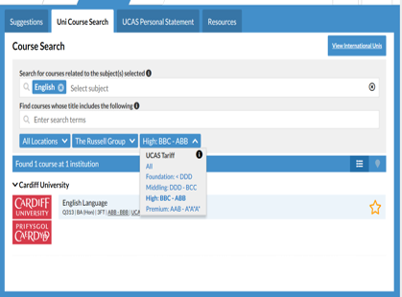
Morrisby course search – good for filtering by Russell Group and grade requirements
Notes:
There is no perfect uni search tool but what’s good about your Morrisby is you’re already in there looking at degree suggestions, can get overviews like we just looked at but you can filter by grades AND type of uni including RG

Slide 14
Flash Task 2
Use the Morrisby Filter Tool to identify a Russell Group university in your degree subject which may have lower grade requirements
Note down in spreadsheet under Flash Task 2
Note down any other choices you wish
3 mins
Notes:
Give example of Cardiff for English
Note that some courses may come lower on results day … more on this later.

Slide 15
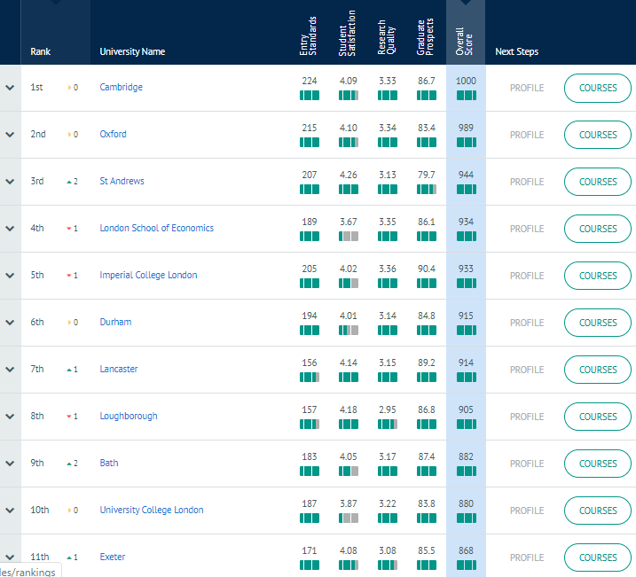
Complete University Guide: Overall Rankings
Notes:
Notice bath is 9th overall

Slide 16
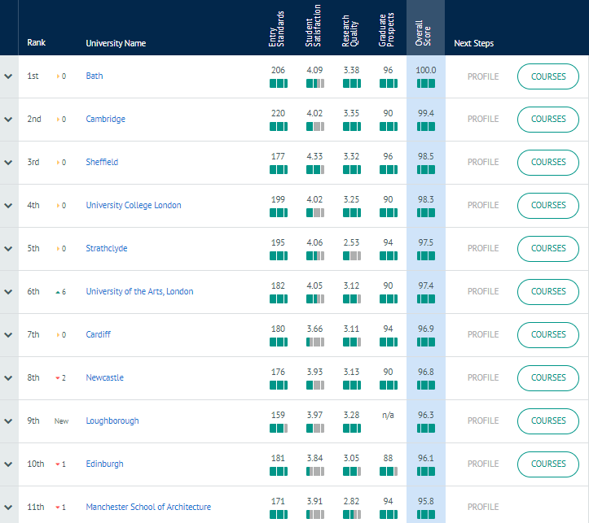
Compare departmental rankings: architecture
Notes:
Bath top for architecture (and not in Russell Group)

Slide 17
Health warnings
Lots of league tables so don’t obsess about small differences
Sometimes stats slightly manipulated, e.g. student satisfaction, so again don’t obsess about small differences
A few places, Russell Group/top uni in league tables not best place, e.g. Art Schools – how do you find out where’s best?
Notes:
How do you find out where’s best? For art school speak to art Department. One thing I do is phone a university I know is well regarded, eg. Sound Recording I knew Surrey had a course like Tonmeister Sound Engineering and I asked about the course and then asked where else does the academic rate.

Slide 18
Flash Task 3
Find Complete University Guide League Table in Subjects You’re Considering
Note down a few universities you want to explore – try to get a range – not all top 3!
Tip: cross reference to see if they are Russell Group
Tip: if can’t find subject specific League Table, look at Overall League Table and then explore your course at these later
Think about other criteria like where they are in the country, are you looking for big city, campus, etc…
3 mins

Slide 19
University: the place
Where is it? But also what’s the “commute time from London”? Birmingham is only 1 ½ hours away
Where do you live through all three years?
What are YOUR “essentials”? Eg. if you big on drama, has it got good student theatre? If you like clubbing, what it’s like? How important is accommodation to you?

Slide 20
What are you looking for on the course?
Does uni have my course? Are there variations of my course (possibly with lower entrance requirements)?
Module content
Study style… how much coursework?
Combinations (not always evident on UCAS)/Specialisms, eg. Liberal Arts or Arts and Sciences
Can you switch course? Eg. Leeds Biological Sciences Dept. - yes
Can you take modules from other Depts? Often they let you so you can study one “single honours” and then pick 20% or so from another course
Notes:
Politics – what Politics and Policy or a new subject like Politics and Sociology… I’m not interested in sociology? How do you know? More later in testing out new subjects.
Modules within degree – not just options but anything that gives more flavour
Study Style – Coursework %, practicals, etc… My law example – problem questions…. Friend who just did sciences.
What then? Phone them with your questions and even think about asking about competitors particularly if niche degree.

Slide 21
What are you looking for?
Industrial Placement Year?
Links with employers for that degree, e.g. internships, projects with employers
Professional accreditation
Example: Edinburgh Politics and Law NOT a qualifying but see what website says…
Employment Prospects
What to do with your personal statement in the application if you are applying for slightly different courses at different universities?
Notes:
Employment prospects - but often general 90% in employment – what exactly….

Slide 22
What are you looking for? Entry requirements
Published entry requirements? E.g. course webpage
Related courses with lower entry requirements? E.g. Cardiff psychology AAA-AAB v Human Social Science ABB (both BPS accredited)
Lower offer for EPQ?
Unconditional or low offers and in what circumstances? E.g. Newcastle – unconditional for Philosophy 2020 entry regardless if put as insurance
What grades were they accepting last year?
Was this course in clearing last year?
Are my GCSEs good enough? Check specific requirements - 4 in maths
Note: don’t rely on clearing as may change AND best accommodation may be gone
Notes:
Obvious entry requirements: grades but more specific things like do they drop a grade for EPQ?

Slide 23
Notes:
If I knew I was interested in politics and I also liked Exeter, I’d type in politics Exeter and look at the variations. Note Politics Streatham and Cornwall and 34 different related courses.
Note the different tariff requirements. 144 is roughly AAA, 120 BBB
Remember if there is a new course combination and you think that doesn’t interest me?

Slide 24
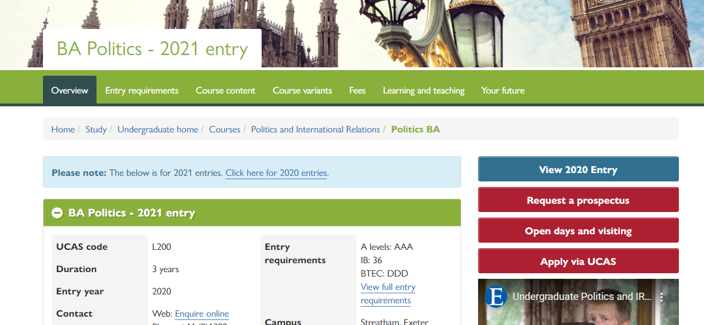
Notes:
Explore some of the things we’ve been discussing like coursework content, industrial placement, entry requirements….

Slide 25
Flash Task 4
UCAS Course Search to find course you may be interested in at a particularly university (e.g. politics Exeter)
Note related courses
Explore these courses and copy paste their links in Flash Task 4 on Spreadsheet for later exploration
Note entry requirements first – is there a range depending courses? Eg. Politics at International Relations at Exeter (Streatham Campus v Cornwall Campus)
Note other areas of interest like how much coursework (this you will have to do more of in own time – see things you are looking for on slides
Are there any answers you can’t find on website? 5 mins

Slide 26
What do you do if can’t find answer on website?

Slide 27
Contact university
Really? Can’t you? If not:
Phone Admissions or if necessary, Department!
Email Admissions or if necessary, Department! (Mr McDermott has an exemplar email)
Ask on Open Day! Open Day List https://www.ucas.com/ucas/events/find/type/exhibition
Notes:
Often I find you can, e.g. whether lower grade on results day.
For example, if trying to find out about the other top unis in a niche area, Admissions aren’t going to know, you need to speak to an academic in Dept either on phone or Open Day.
Do an example. Hello could I speak to admissions? Undergrad or postgrad? Undergrad please. Hi. I’m looking at your sound engineering course…. I have a few questions? Could I check whether this is . I’m applying for engineering different courses elsewhere and didn’t know what to do. That’s ok we understand people do that and so if you could maybe just may some links between engineering and sound that could cover you and we will also accept an additional.
Do you know what this course was accepting people on last year? I believe very close to the typical offer because it’s very popular, so I think it was AAB from an AAA offer.
I know it’s a very specialised course and I’m very interested in it but obviously I have 5 choices. I don’t know where else is good for it? Sorry wouldn’t have a clue about that.
Then what might you do?

Slide 28
This is why visiting is a good idea: Mr M’s idea Of Birmingham

Slide 29
What Mr M found:
Notes:
If no open days, visit yourself or there may be open days in Autumn Term (don’t miss school!)

Slide 30
So you get your 5, say:
2 aspirational choices: high grades you could get and for unis who don’t move on results day much (e.g. Durham, UCL, LSE, etc.)
1 or 2 “happys”: great university which you can get entry requirements or have on good authority (i.e. you checked!) may move on results day .
1 happy reserve, e.g. lower grades or just a bit lower than the above. These can often still be top RG universities
Notes:
This will vary depending on your particular profile… you might want more reserves if you your grades are more variable. But remember 97% RG last year so so long as you explore probs be ok.

Slide 31
KAHOOT
TIME

Slide 32
Exploring subject in more depth through “super-curricular”
Why?
Notes:
Why? Can help you decide what to study (what really interests you) and then once interest confirmed, helps you write a convicing UCAS application, particularly the personal statement.

Slide 33
Super curricular tip
“Read”* broad (particularly if it’s a new subject you’re considering), then in a few areas of interest, read deep.
*read can mean books, articles, lectures online, podcasts, etc…

Slide 34
Exploring Your Interests…
Reading… Books and Articles (JSTOR and Google Scholar, etc...)
Top tip: Good introductory books, e.g. “OUP’s A Very Short Introduction To….”
Lectures… at the university but also online
MOOCs: https://www.futurelearn.com/ https://www.coursera.org/
Podcasts…. https://podcasts.ox.ac.uk/
Essay competitions… Section 4 of https://learn.surbitonhigh.com/careers/newsletters/
Open Days
Key resources 2020 and Subject Specific Resources - I will shortly giving you links to where you can find the above
Notes:
Introduced your daughters to….
Books – get recommendations but don’t read something everyone reads…. You can get reading suggestions from teachers and reading lists from uni websites
JSTOR, Google scholar – articles are great because more unusual and specific…
Courses – MOOCs – mini university courses
Competitions – great way to develop depth in a subject and have something at the end of it….
Open Days – can really find out more, even more than phoning, often do lectures as part of this.
New subject – haven’t studied before, you aren’t going to have luxury of knowing what the subject is really like from your A levels.
So I’m going to work through a law example…

Slide 35
Sources of supra curricular
Use the “Key Super Curricular Resources 2020” and “Subject Specific Research Resources”
Careers and HE Newsletter! https://learn.surbitonhigh.com/careers/newsletters/
(Also great for apprenticeship and employment ops)

Slide 36
Exploring Your Interests…
Notes:
MOOC –for law – intro to law but could be much more specific. Have a girl interested in marketing and maths and I suggested Data Analytics Marketing and found lectures in this. Two big directories for MOOCs: Cousera and FutureLearn.

Slide 37
Exploring Your Interests…
Notes:
Intro book – get recommendations from people – particularly academics on that course at unis! Gives you an overview, you may need this less for subjects you currently study but can still be useful as you’re only a 1/3 through the course. Very Short Introductions to Guides are great because they’re quality and short!
What interests you? In this case say I really liked that law involves solving problems in an almost scientific way. Say I found particularly interesting an example in the book of two friends who buy a house together and then they fall out. What are each friends’ rights?
Another thing I liked was that studying law is also about asking big questions not just applying the law and asking what the law should be? Even, is the law just? Learnt that there were theorists who were very critical like Marxist jurists and queer theory jurists.

Slide 38
Exploring Your Interests in more depth
Notes:
Then I read land law chapter of to solve the riddle of the people who bough house together and feel out (10 pages!) to test I like and can do legal problem solving.

Slide 39
Getting More Specific, say article on Google Scholar
Notes:
Another thing I liked was that studying law is also about asking big questions not just applying the law and asking what the law should be? Even, is the law just? Google English law and Marxism on google scholar found an article by Smith on Google Scholar on “Marxist critique of English law.” writing in 19th century Understood idea that law protects those in possession, eg. the rich, and not those without, eg. the poor. In other words, the law works in interest of

Slide 40
Exploring Your Interests: Getting More Specific
Notes:
This got me thinking – is this criticism still true today? We treat the rich and the poor differently in the legal system, including criminalising what the poor do and not so much what the rich do? This lecture on the different treatment of bankers who sold worthless financial products in Financial Crash of late noughties to

Slide 41
Personal Statement Task
Read the law personal statement for 10 minutes and then discuss it
Does the person sound like they know about law and are interested in it? How?
Does the person sound like they’d be good at it? How?
What’s wrong with it?
15 mins
Notes:
Does the person sound like they know about law and are interested in it? Yes because they have discussed different aspects of the course in the first paragraph – the why of the law and the what of the law and they have done a legal problem? Shows relevant initiative.
Rather than listing lots of reading and areas they have identified one main theme – where the law is unjust – way it protects the rich at the expense of poor and debated this. Is this still relevant? Yes talks about the financial crisis.
Then identifies another areas of injustice. Laws treatment of gay people and returns to theme about morality of law. Extent law reflects morality of the times.
Good at it? Mention asking big questions in history and philosophy, mentions that can also apply the law using mathematical brain and giving example of doing this by solving a problem by reading Land Law Nutshells. It is also well written, infers person can write and it is very critical.
Also mentions reading case law and understanding the value of it – a law tutor will LOVE this because everyone just reads the textbook.
Ultimately this shows a person who is able not just to apply the law but also ask why is the law the way it is and is it right? This is a perfect student for studying law as an academic discipline rather than just a conversion course to get a job.
What’s wrong with it?
Already 6000 charatcers and they haven’t included work experience and extra curricular

Slide 42
Personal statement – good things
I’ve shown myself I’m interested by doing this “reading” and can also write the paragraphs demonstrating “Why this subject” by:
Overview of law from OUP Very Short Introduction to Law and finding out why one might do law and not a law conversion
Talk about a legal problem (new type of study that you will do on law degree) – read chapter of “Land Law Nutshell”
Then something specific and interesting and ideally a bit critical.
Is the law just? Does it criminalise the poor and protect the rich? 19th century Marxist article, RS A level studies. Is the Marxist view relevant today? Cambridge lecture on 2012London Riots/rioters treatment v treatment of bankers
I can also include a little on work experience and extra curricular if I have space
Notes:
Going through this process equals:
You’re much more likely to know you’re engaged in the subject your considering
Also… It gives you great the foundation of a great personal statement.
If you map out the subject a bit which if you’re studying is pretty easy but then choose one or two areas, which you can talk about in depth because you’ve done a MOOC then read specific articles in that area…. You will write a personal statement…

Slide 43
Bad things?
Already 4000 characters above limit and they haven’t finished….
But the good news: this is already a very good personal statement and only required one general intro book on law (100 pages), one chapter of a specific area of law – land law nutshells (10 pages), Smith’s article (10 pages) and watching a lecture
Shows benefit of broad, short reading and then focusing on a few areas of interest to write personal statement
I would not cut the above too much just to make space for extra curricular and work experience. Keep this short as the above is much more relevant.
Personal statement also shows you CAN’T include everything in depth in a personal statement (you will have to edit some relevant stuff you have done often)!

Slide 44
Very Vocational Course Like Healthcare*
May need to reflect understanding of profession much more: competencies and evidence you have (or capacity to develop -STAR answers). What are you going to do to do this?
*less so somewhat vocational like law or engineering but some work experience in personal statement welcome provided it shows why you’re interested in the degree (e.g. covers topics you would encounter on the degree)
Notes:
Most important in healthcare degrees. A little bit in other vocational degrees like engineering, law, etc… BUT

Slide 45
Flash Task 5
Use the “Key Super Curricular Resources 2020” and “Subject Specific Research Resources” documents
Find one or more super curricular that you could use to productively explore your subject.
Eg. “A Very Short Introduction to Engineering”
Put in Flash Task 5 in Spreadsheet
Notes:
If time show them how to use by opening the document and searching for a Very Short Introduction and using Downing website.

Slide 46
KAHOOT TIME – Personal Statements

Slide 47
Main Takeaway on Personal Statements
You will get more help on personal statements but the main thing to take away today is:
start exploring your subject broadly but efficiently
develop a few areas of interest where you can talk about some of the issues in a critical way like you do in an essay/EPQ/debate in science

Slide 48
Next: What to do?
See law tab example on the spreadsheet that summarises the process/activities in this presentation
Notes:
a spreadsheet to record a lot of what I have said and links to key resources like the MOOC search engines. It contains a worked through example for law to show you the kind of things you should be recording. I know some of them will have their own but many don’t and this is hopefully a new, helpful innovation this year.

Slide 49
Next: What to do?
Now Complete the spreadsheet for you
To help you, open document “Girls Briefing for Exploring Courses and Completing Spreadsheet” helps to tell you what to do
Your focus will be different depending where you are at, so have split actions depending on girl:
Don’t know what you want to do
Doing a “school subject” degree
Doing a “new” subject
Doing a vocational subject, eg. medicine or engineering
ONGOING TASK FOR EASTER AND SUMMER HOLS!
Notes:
I arrived back from Christmas and there were brochures, leaflets, overload…. And Thought to myself, no wonder students make rash decisions, there’s just too much info… So understand why you do that but you can make the wrong decision….
So what I want to do is give you a little bit of structure to help you shift through this info overload
Existing subjects – 2/3 can be entered with any degree - if enjoy, if good at it, good starting point
New subjects – even more research because it’s more likely if you haven’t studied it before that you may have a misconception about the course and I sometimes find those who choose a new course do so because they think the grass is greener on the other side, that is a new subject is going – so girl wanted to apply for a law degree, I wrote a legal problem question and gave her a law textbook and said go away and do that…. Because that’s what you;ll be doing on a law degree because they have no idea and quite understandably why should you…
Specific to a career – have a fairly good idea you want to do it and the other thing to ask yourself is if I don’t do this degree, what is the entry route into that career. For example, for law, to put yourself in the same position as a law graduate you only have to study for an extra year but for medicine it’s 4-5 years if your first degree isn’t in medicine.
Also – would you prefer a more vocational degree that assesses you based on professional practice rather than just exams – eg. hospitality or a healthcare related degree… May not be right for some but is right for others.
If considering a vocational degree, what do you think is an important thing to do beforehand?

